Slide 1

Department of Computer Science and Engineering
SECUREX
CCTV security service booking and management system।
Course Code: CSE 4100 • Field Work / Industrial Training Section:7A
PRESENTED BY
SUPERVISED BY
Md. Nazmus Shakib
Md. Zahid Hasan Rabbi
👤
👤
ID: 11220320852
Lecturer, Department of CSE
PHP Laravel
MySQL
Google OAuth
SMTP + PDF Invoice
📅
August 2026

Slide 2
Presentation Agenda
OVERVIEW
02
Project Overview
Architecture & Stack Feature Overview
Public Website
01
3–4
02
03
Problem, motivation & objectives
8–9
Homepage & service catalog
Laravel MVC & technologies
5–7
Authentication
Workflow & Booking
Dashboards & Admin
04
10
05
06
Login, sign-up & Google OAuth
Flowchart, tree & slot validation
Dashboard & control panel
13–15
11–12
Automation & Results
07
Email, invoice, outcomes & limitations
16–19
SECUREX

Slide 3
Problem & Motivation
PROJECT OVERVIEW
03
Current Pain Points
Securex Solution
Manual booking system
Double-booking risk
No automated notifications
No admin dashboard
Error-prone workflow
Online booking platform
Slot conflict detection
Email and PDF invoice
Full admin control
Booking history tracking
SECUREX

Slide 4
Objectives & Scope
PROJECT OVERVIEW
04
Simplify service discovery
Secure authentication
1
2
Centralize admin control
Prevent booking conflicts
3
4
Automate customer follow-up
5
Prepare for future deployment
6
SECUREX

Slide 5
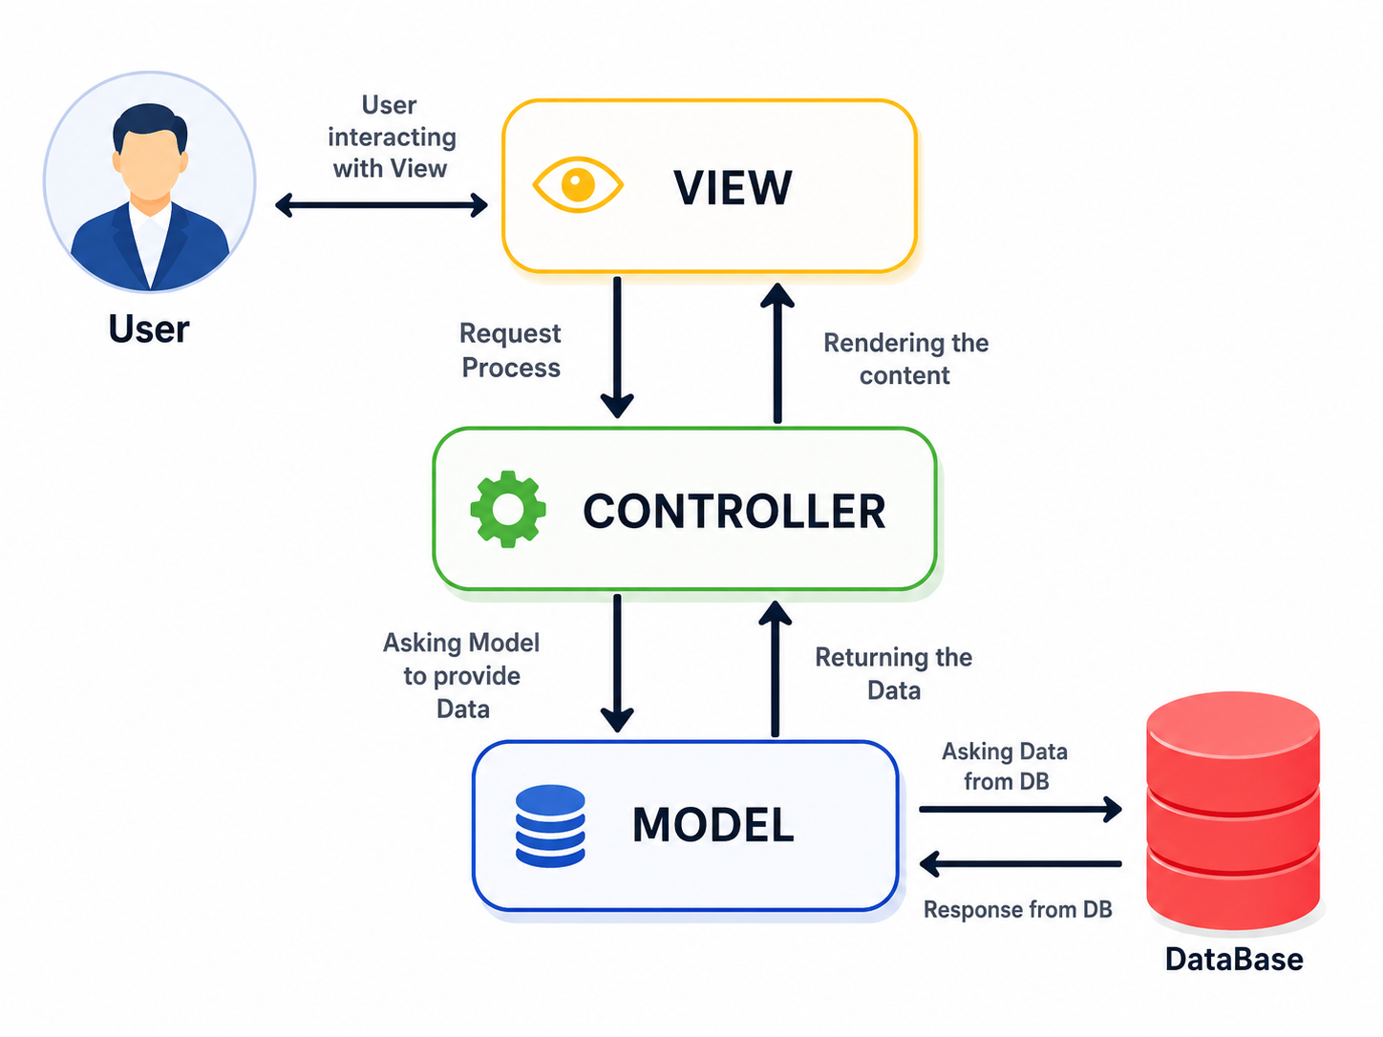
System Architecture
LARAVEL MVC
05
Laravel
SMTP
MySQL
DomPDF
OAuth
Blade
Clean MVC separation keeps routes, controllers, models and views.
SECUREX

Slide 6
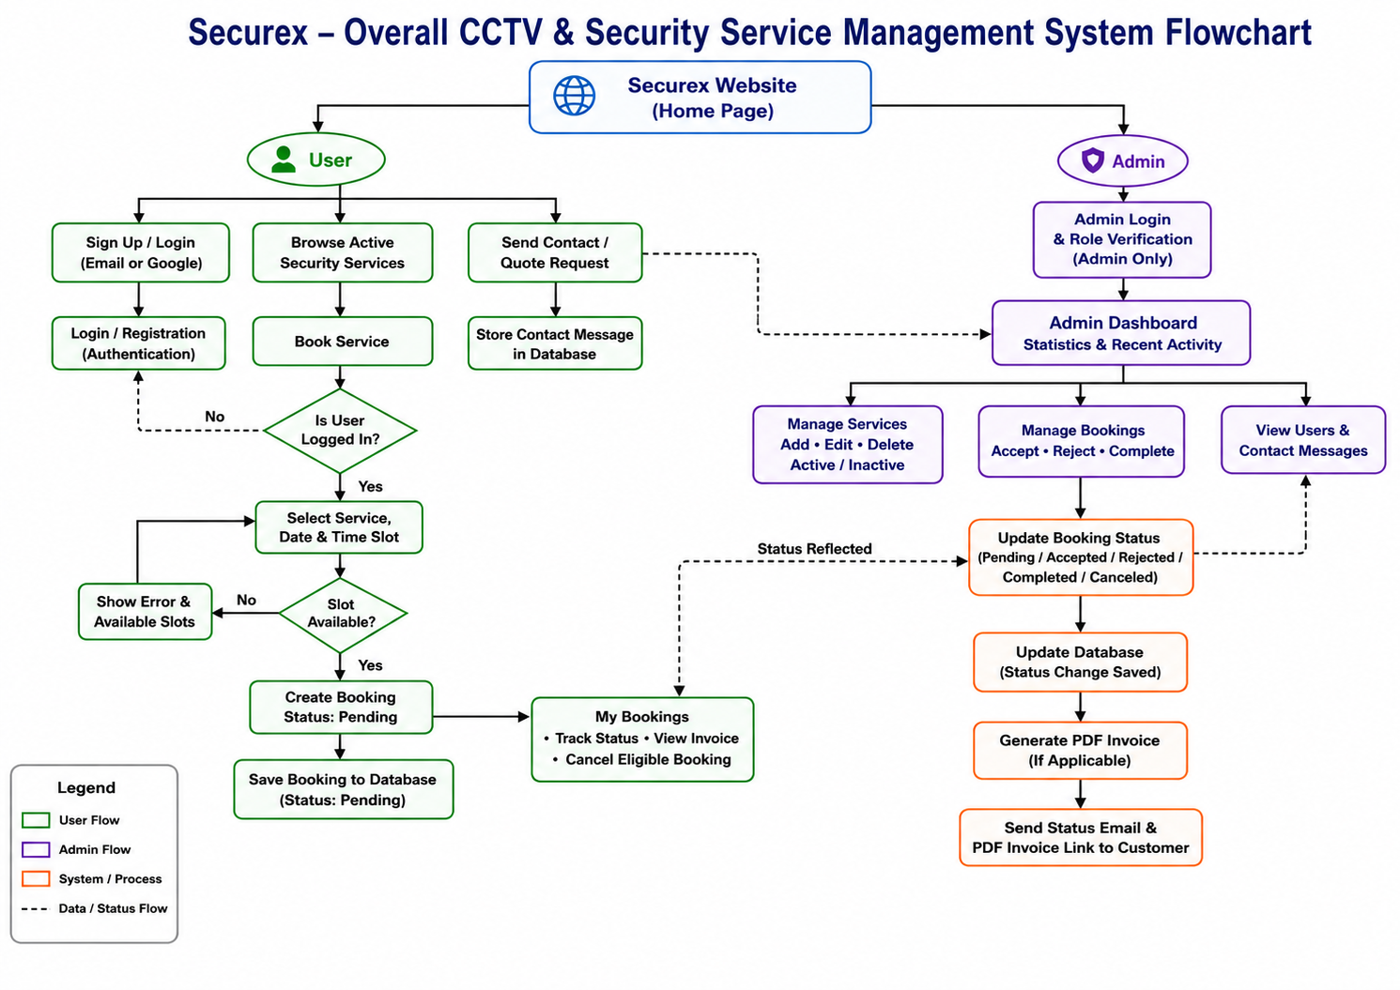
Overall System Flowchart
WORKFLOW DIAGRAM
06
SECUREX

Slide 7
Simplified User & Admin Structure
WORKFLOW DIAGRAM
07
Website
USER
Admin
• Login
• Browse Services
• Select Service
• Check Slot
• Create Booking
• My Bookings
• Dashboard
• Manage Services
• Manage Bookings
• Update Status
• Send Email
• View Users
SECUREX

Slide 8
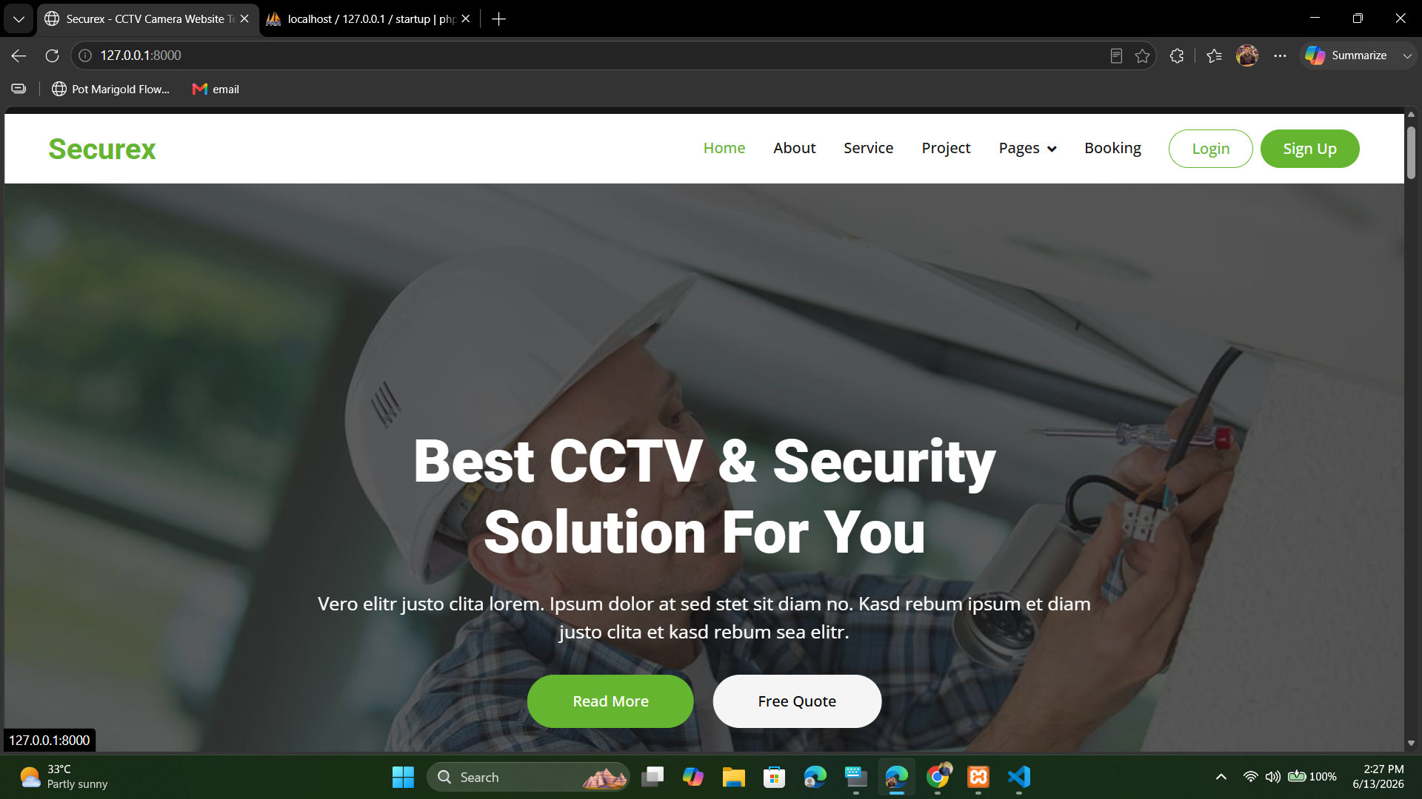
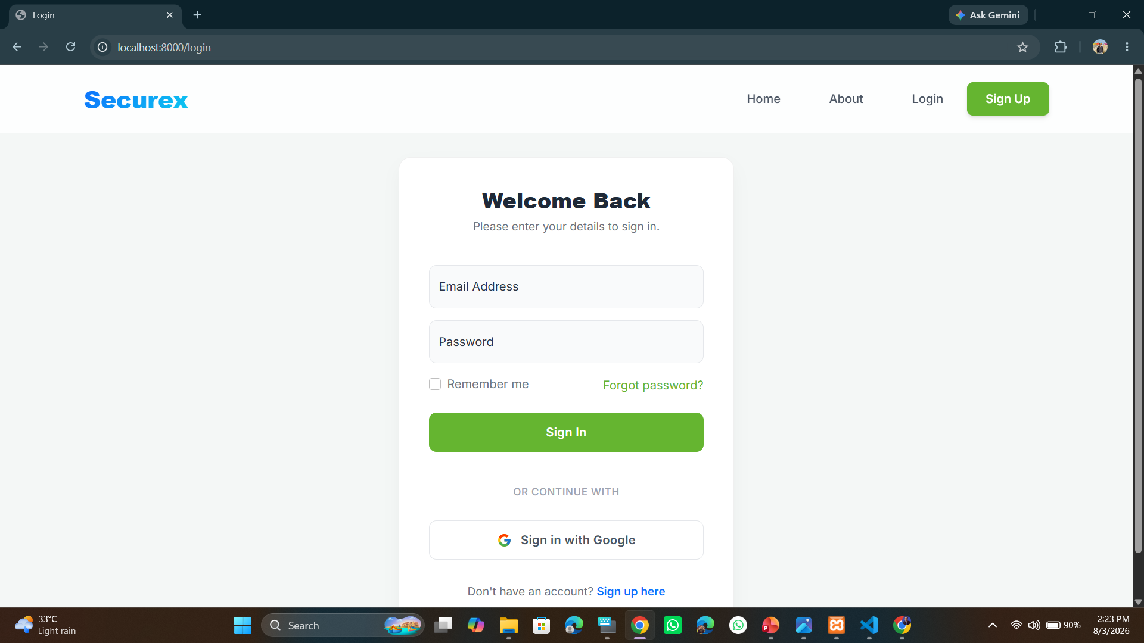
Public Home page and Login Page
CORE FEATURES
08
SECUREX

Slide 9
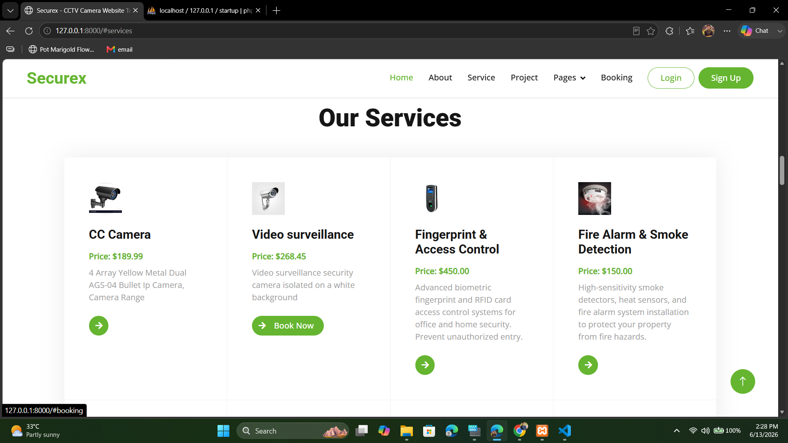
Services Catalog
CORE FEATURES
09
View service
image and title
Check
service pricing
Book services directly
Instant
admin updates
SECUREX

Slide 10
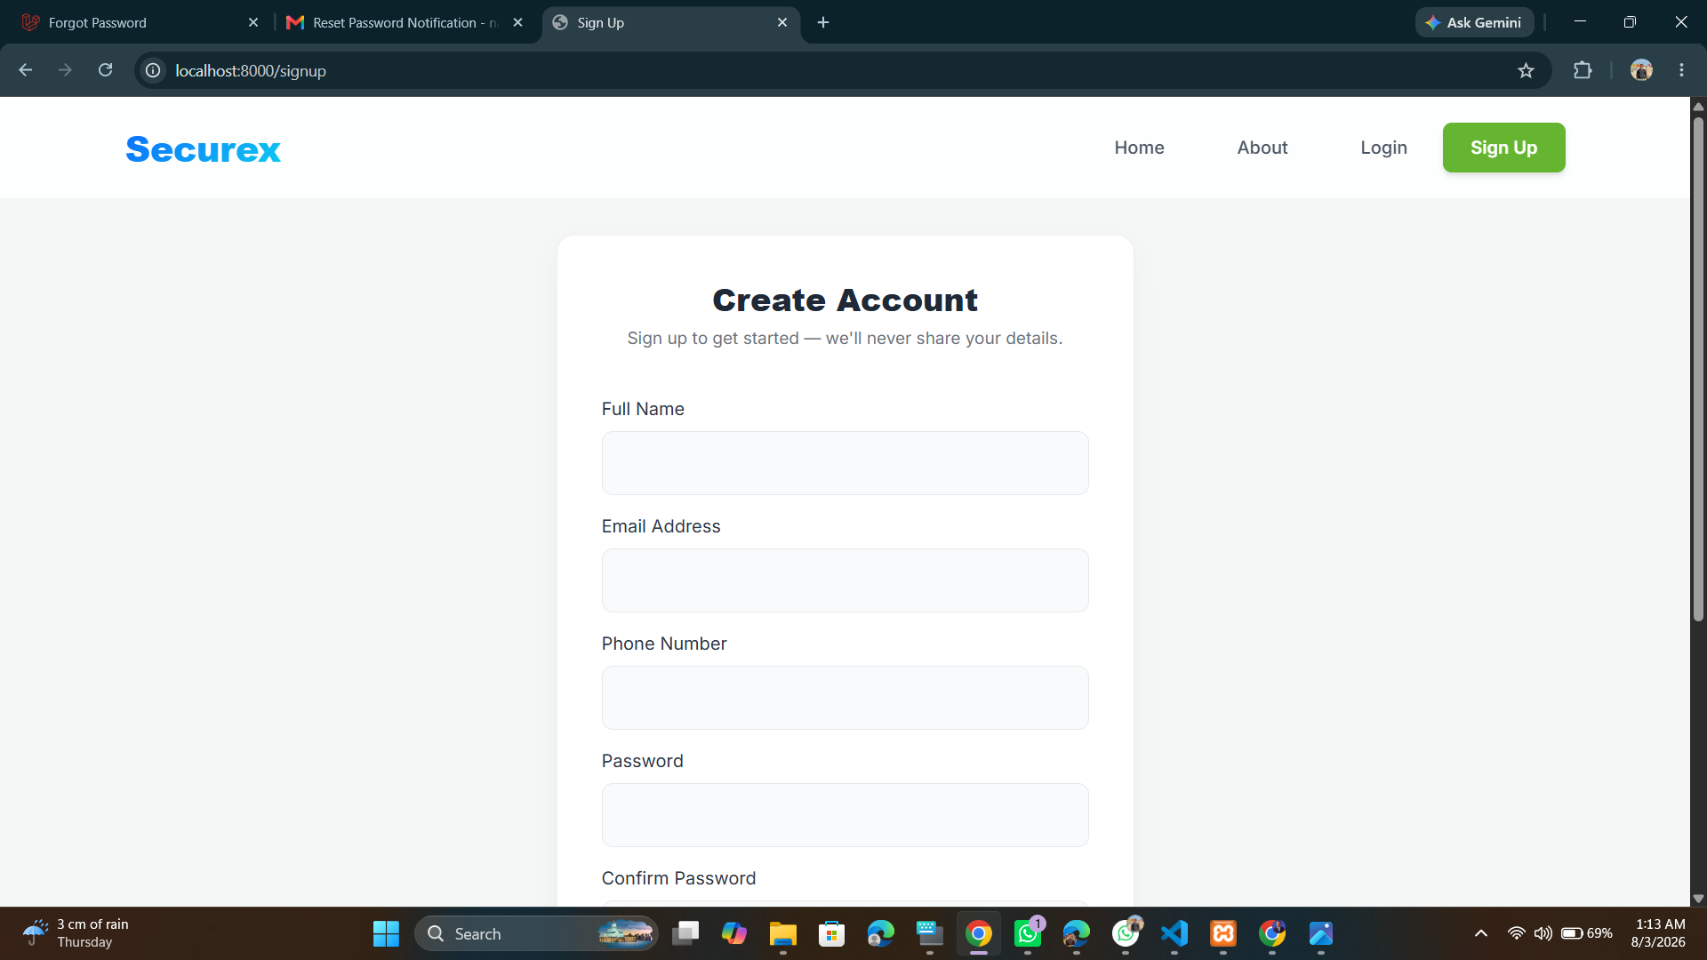
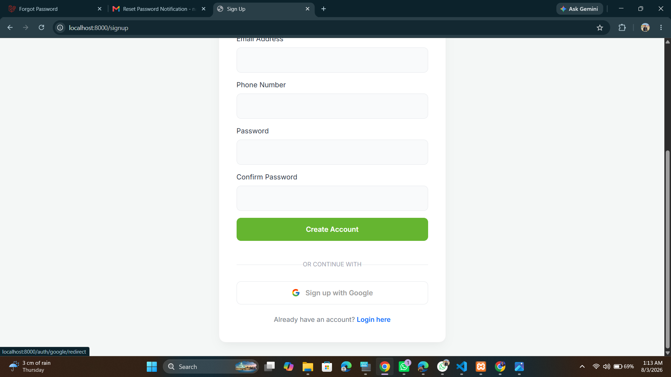
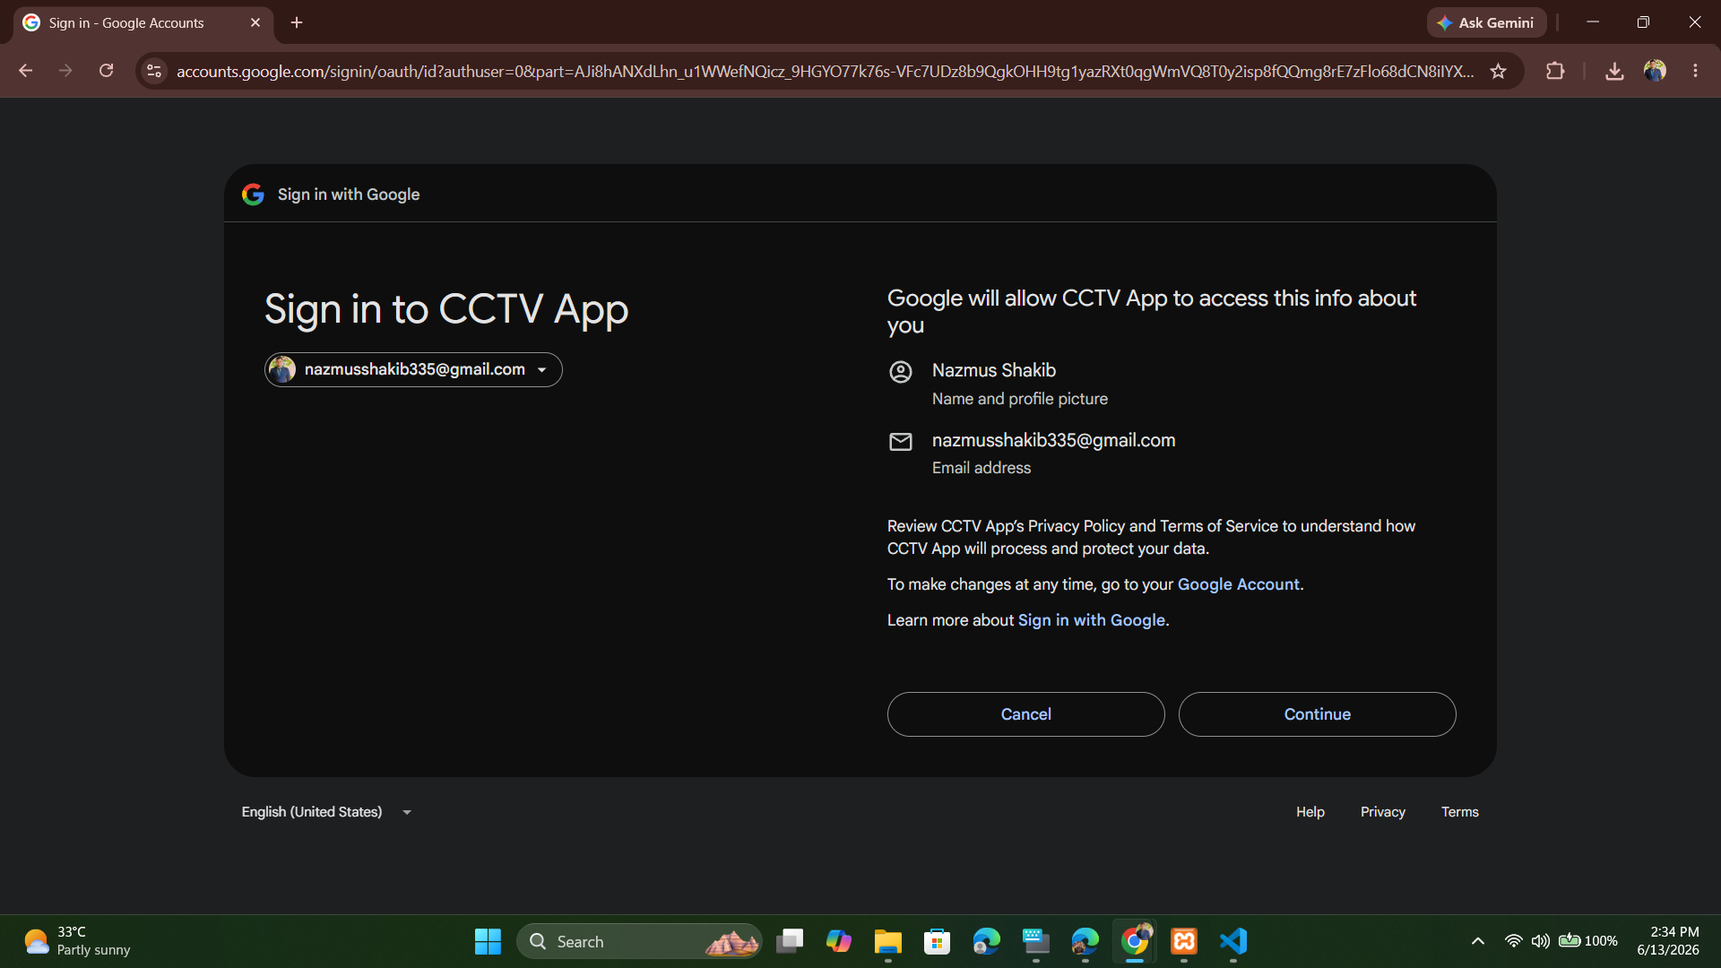
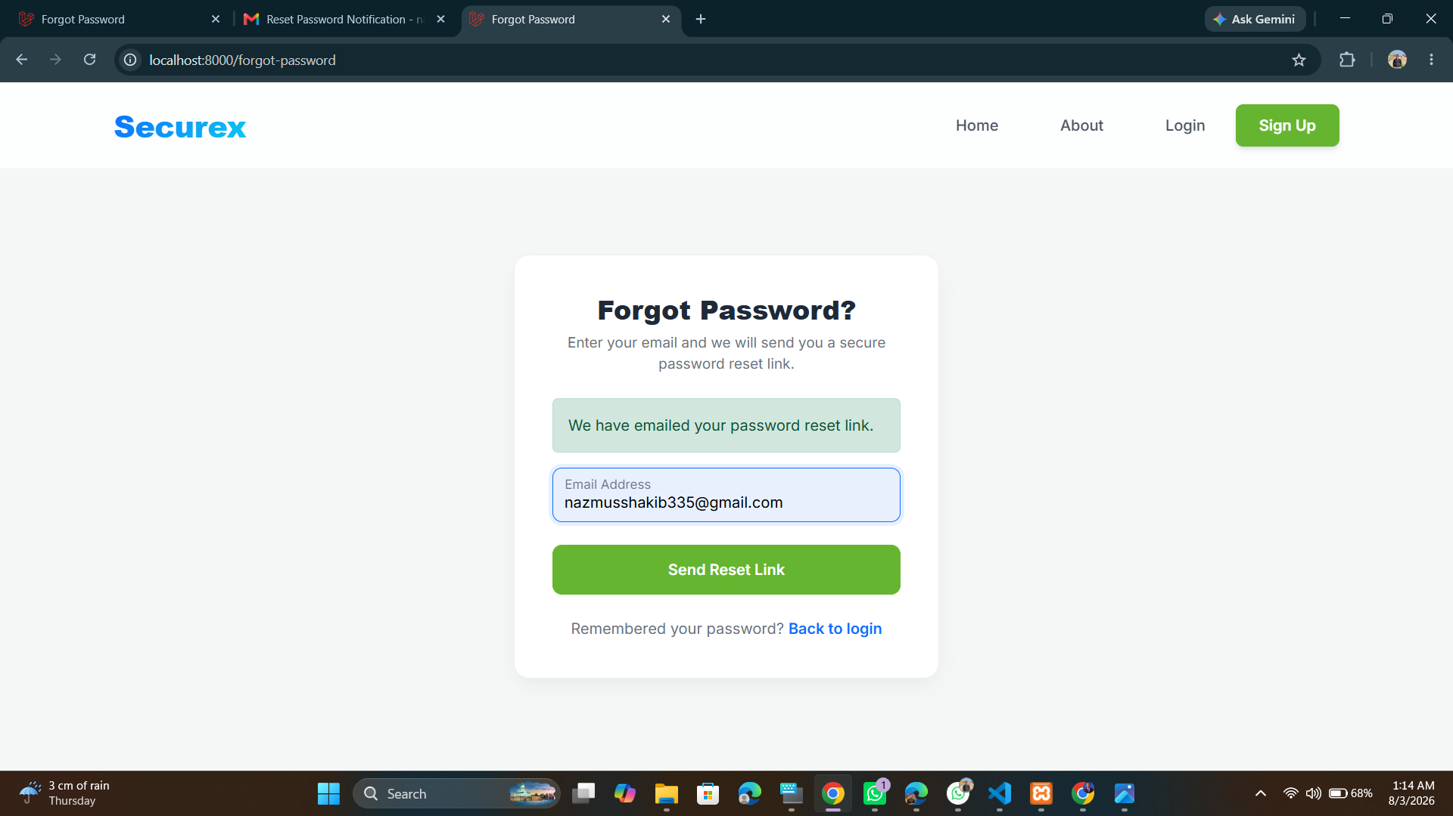
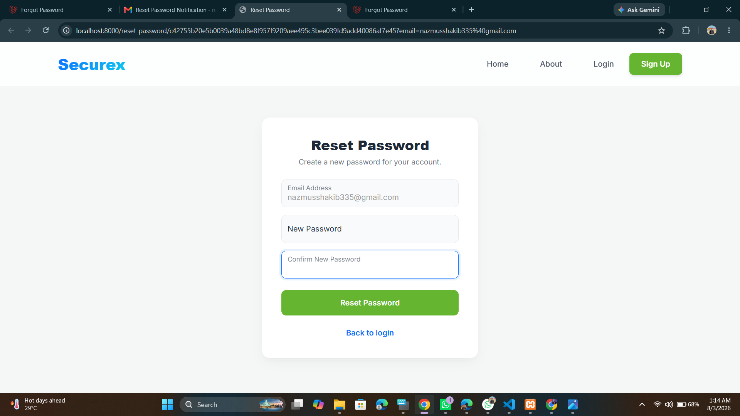
Login & Sign-Up
CORE FEATURES
10
Authentication entry point
Google OAuth 2.0
SECUREX

Slide 11
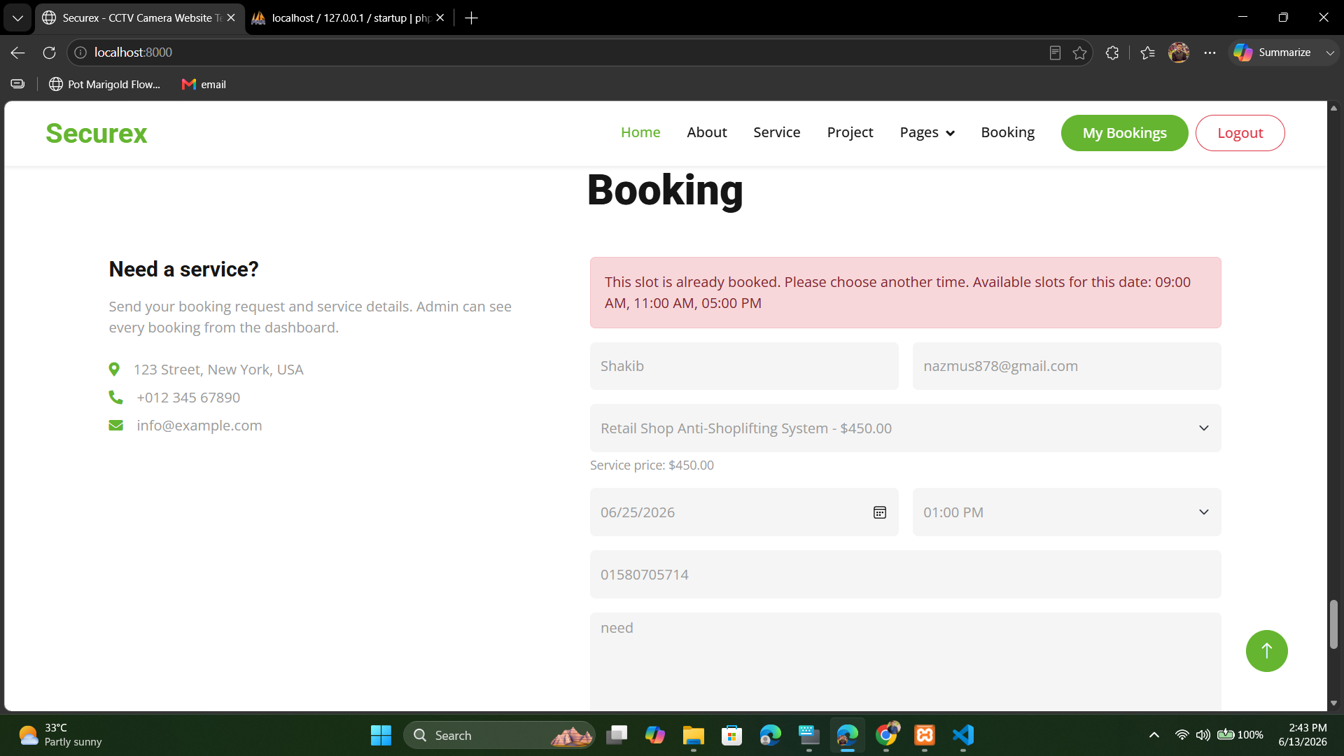
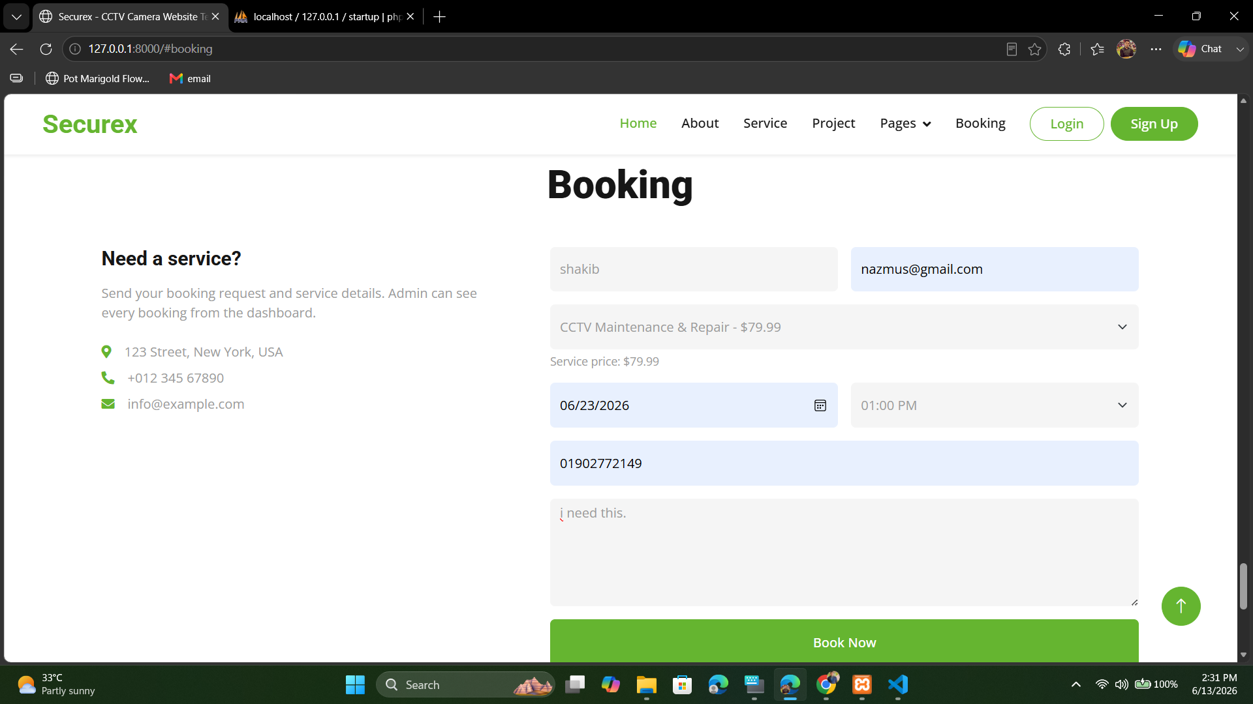
Slot Conflict Detection
11
BOOKING WORKFLOW
Result: double-booking is
blocked before data is saved.
SECUREX

Slide 12
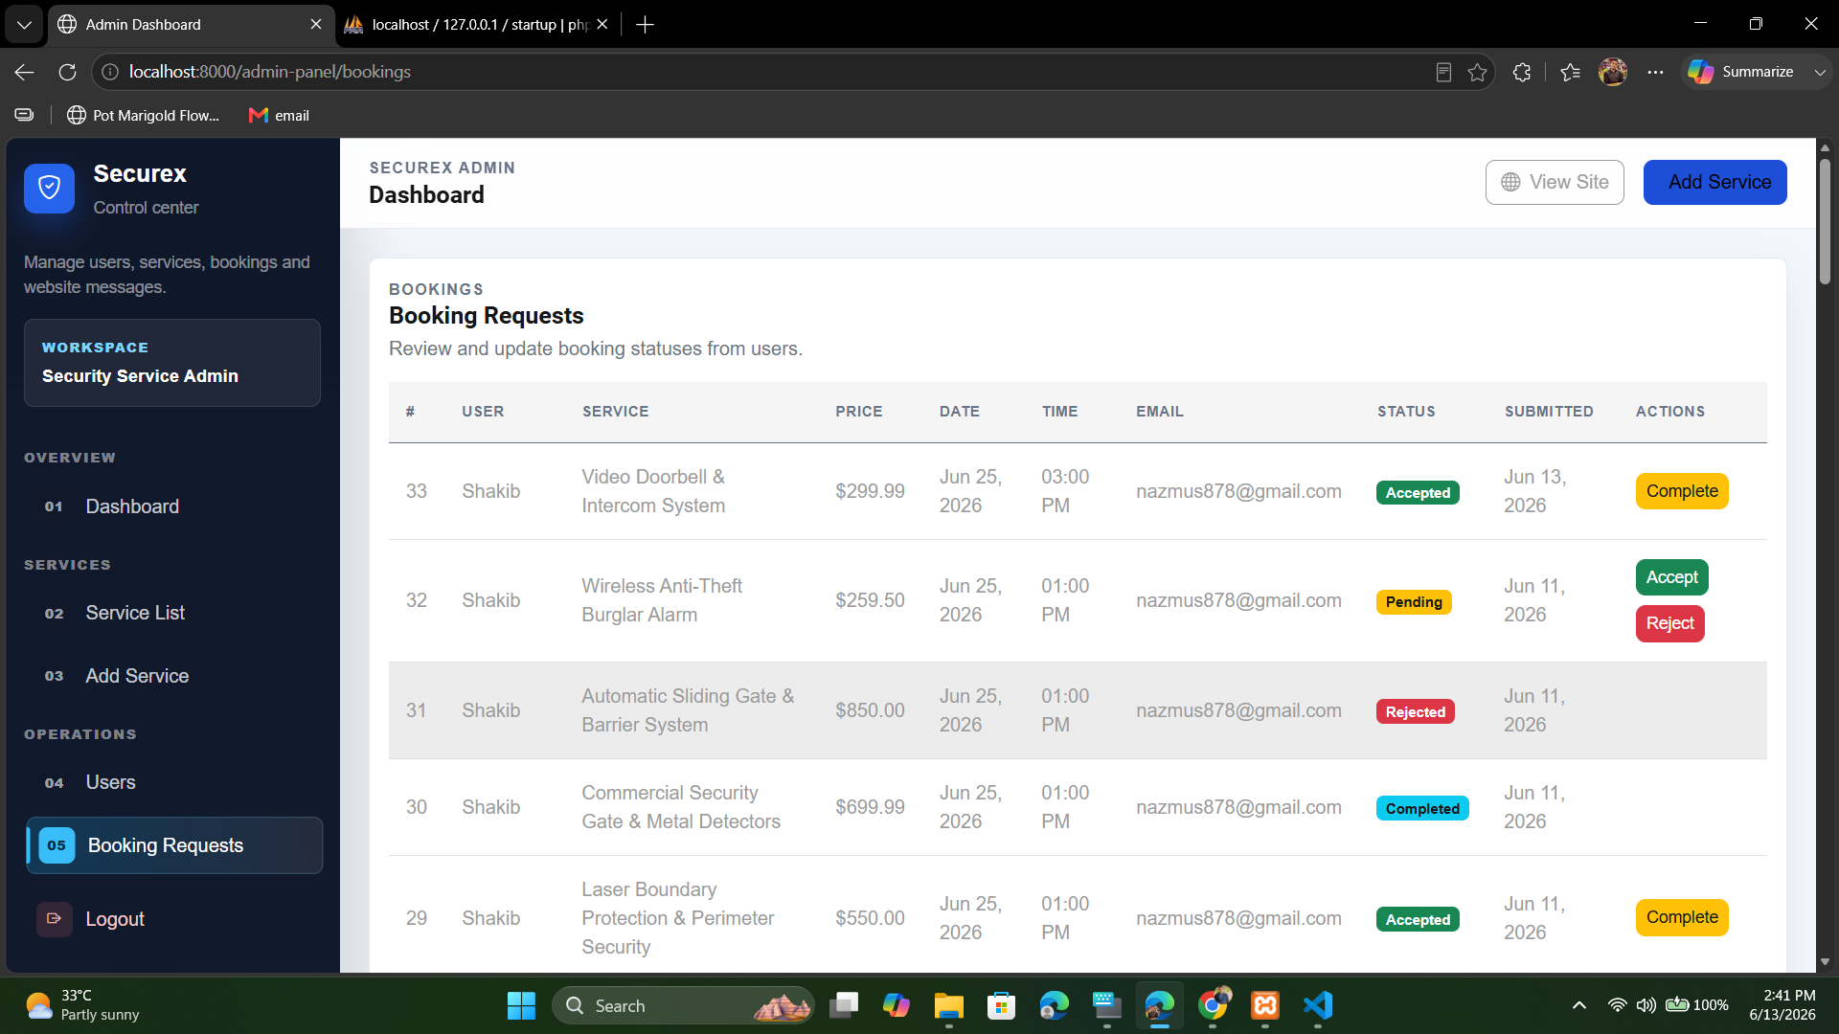
Booking request Admin
CUSTOMER DASHBOARD
12
Pending
Accepted
Rejected
Completed
Cancelled
SECUREX

Slide 13
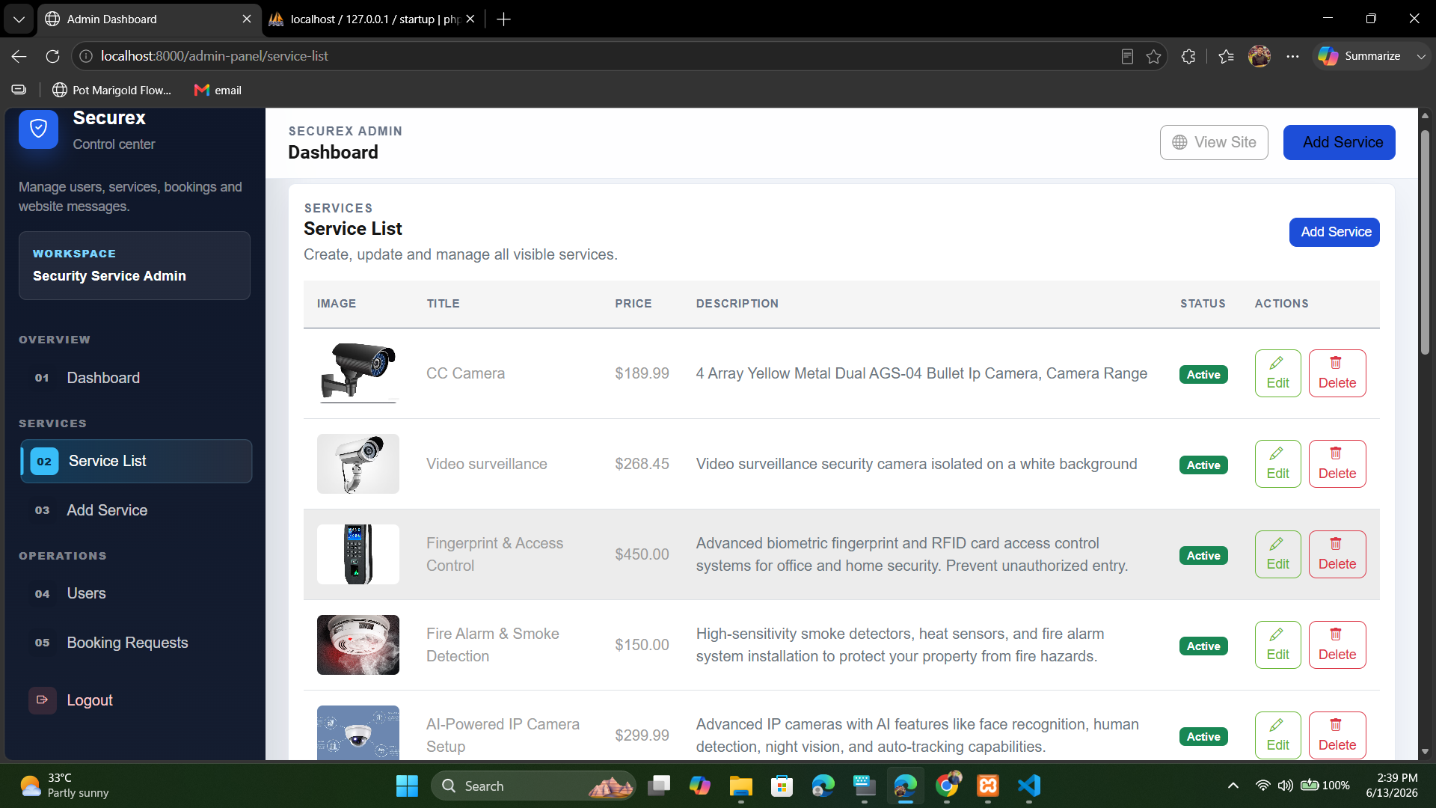
Admin Service List
13
ADMIN PANEL
Add new services
Edit or Delete
Check
service price
View all services
SECUREX

Slide 14
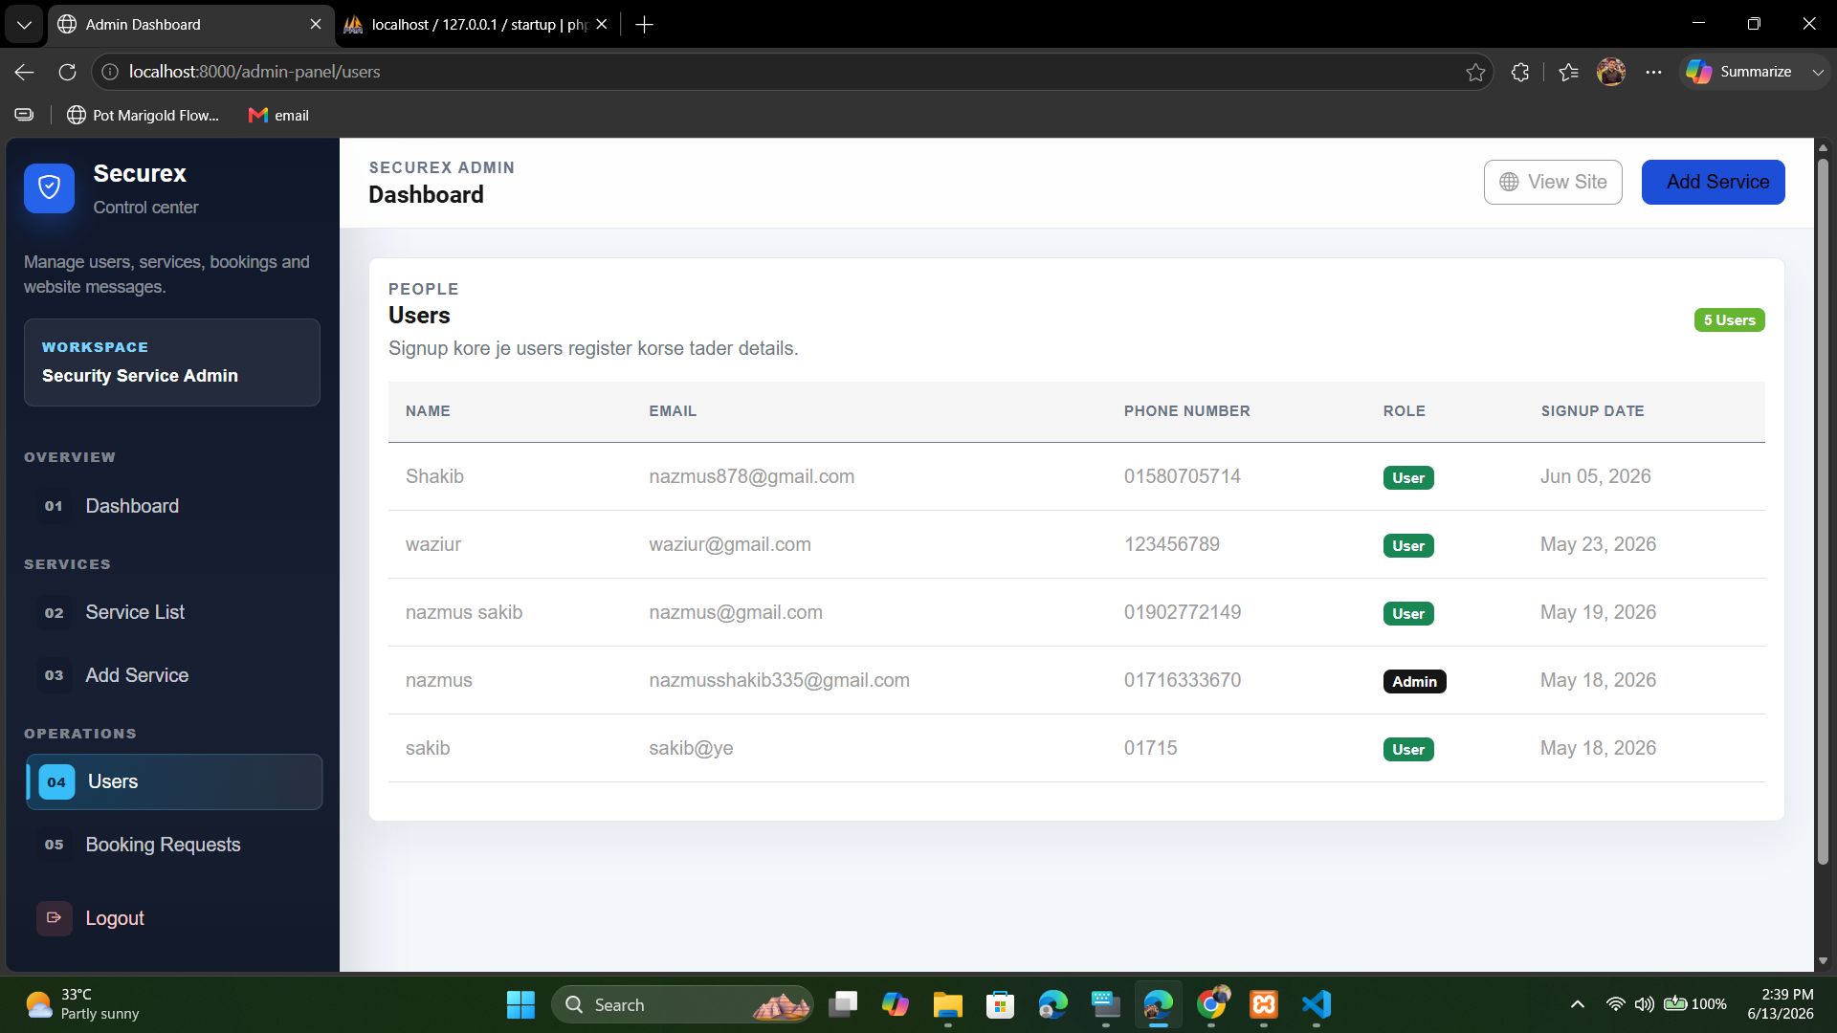
User Management
14
ADMIN PANEL
View user details
Identify admin
Normal Users
Track user signup
SECUREX

Slide 15
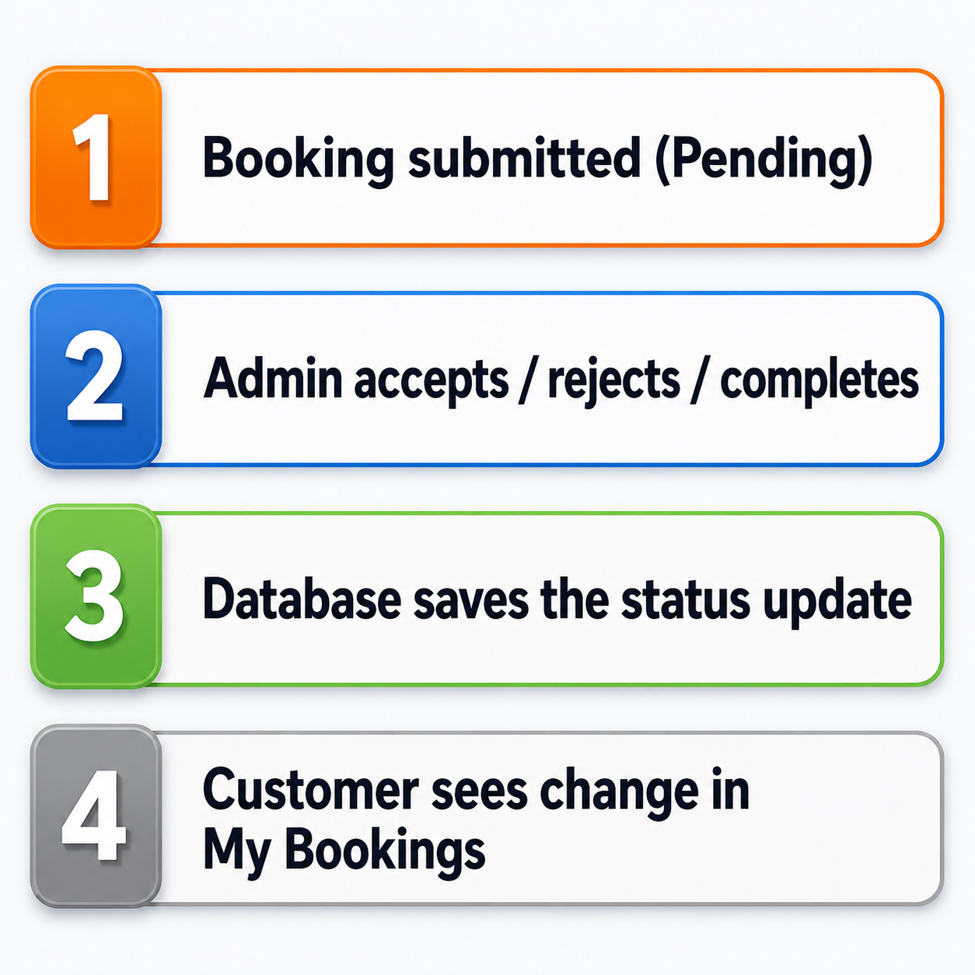
Booking Requests Management
15
ADMIN PANEL
SECUREX

Slide 16
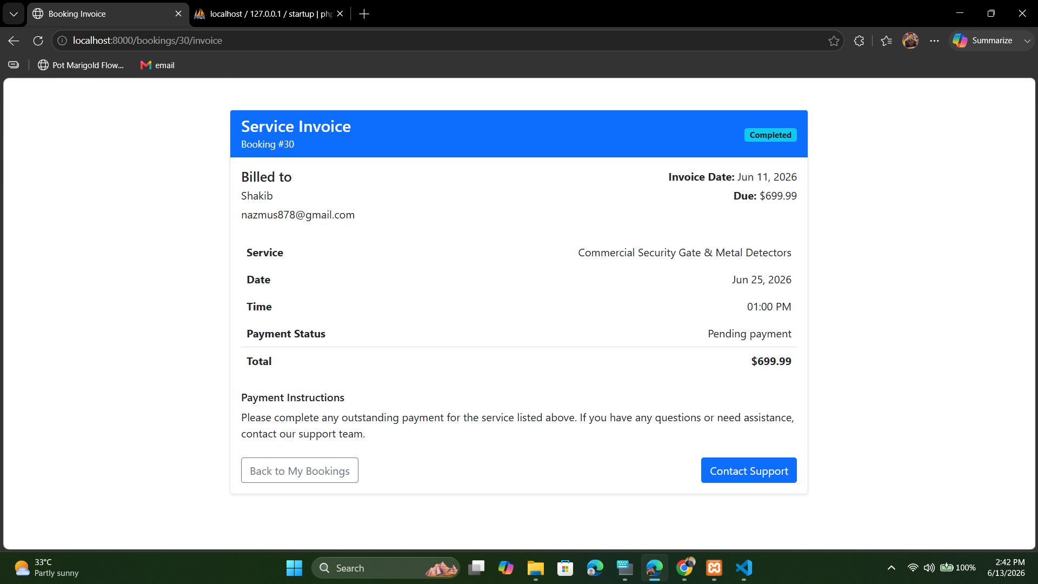
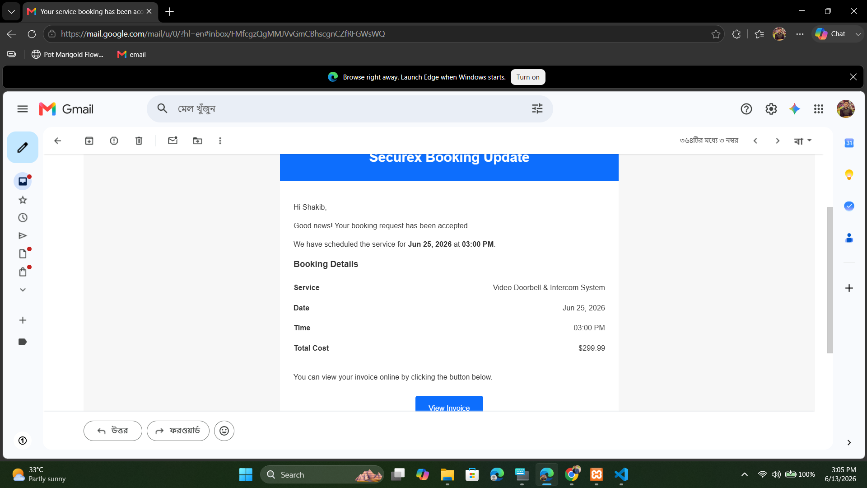
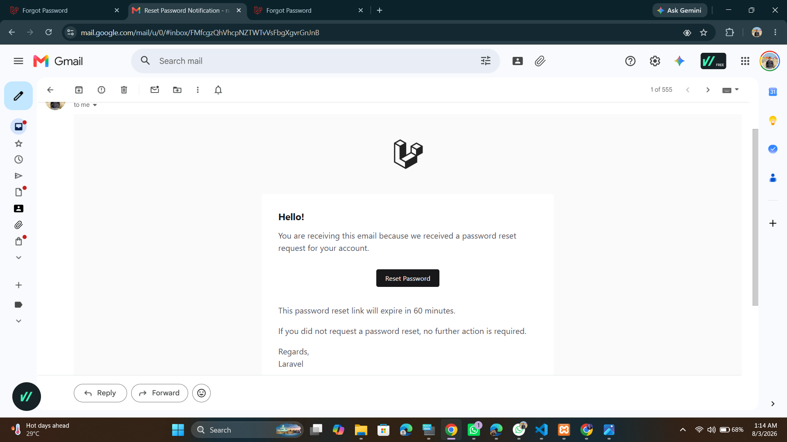
Email Automation
NOTIFICATIONS
16
Notification automation
SECUREX

Slide 17
Technical Challenge: Routing Refactoring
17
CHALLENGE
The Problem
The Resolution
Blade template links pointed to static file paths, causing 404-style navigation failures.
href="about.html"
Navigation was refactored to Laravel route() helpers for dynamic, maintainable URLs.
{{ route('about') }}
SECUREX

Slide 18
Key Outcomes & Results
RESULTS
18
Dynamic Frontend
Dual Authentication
Zero Double-Bookings
Full Admin Control
Automated Comms
Bug Resolved
Securex is ready for real-world demonstration: discovery → booking → admin review → email confirmation → invoice.
SECUREX

Slide 19
Limitation & Future Work
CLOSING ROADMAP
19
Limitation
Future Work
• bKash / Stripe payment gateway
• Live technician GPS tracking
• Real-time in-app chat
• Ratings, analytics and mobile app
• Payment gateway not integrated yet
• No live technician tracking system
• No real-time chat support included
• Mobile app not developed yet
SECUREX

Slide 20
Thank You…
SECUREX

